Slide 1
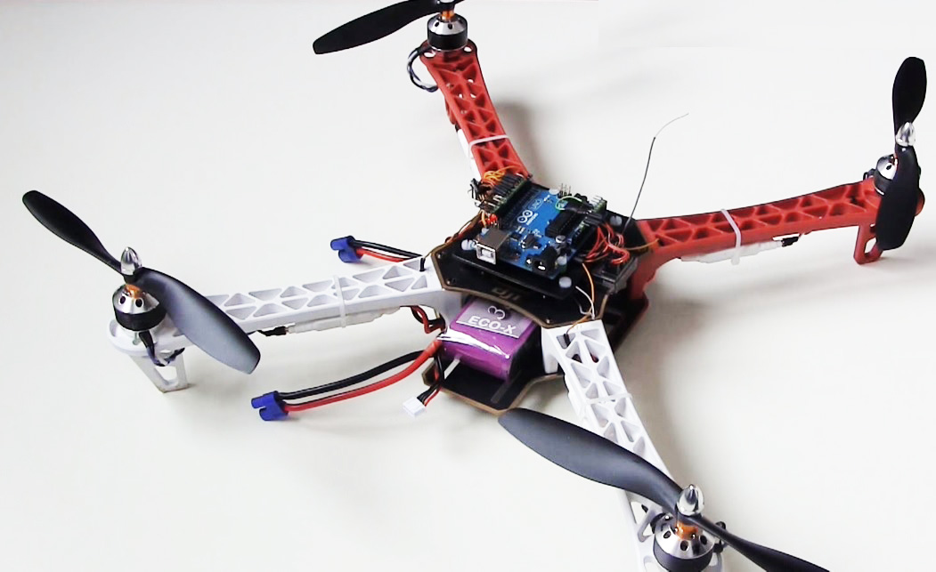
Multipurpose Robot
Project by
Srushti Narvekar (16IT6154)
Aditi Dhakate (16IT1002)
Project Mentor
Nikita Kulkarni

Slide 2
Objective
Main objective of our project is to make a quad copter which could be used in rescue missions
Quadcopter will be controlled by an Arduino which will be program flexible according to the user
GPS module, Camera, Temperature & Humidity sensor, Gas detector, Vibration sensor etc. will be used for multipurpose
GPS module would give the coordinates of the quadcopter to where it will be flying and the camera would provide live streaming of the area back to the ground controller

Slide 3
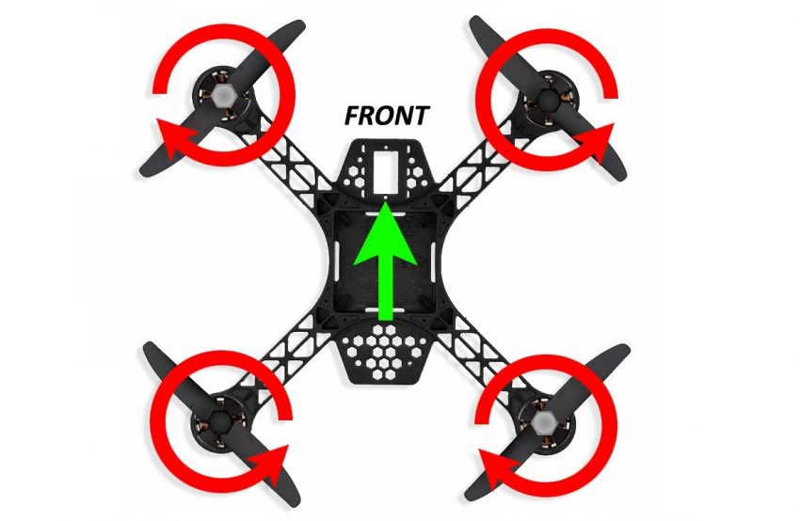
Multipurpose
It can be used to survey a remote location from a safe location without actually going there.
It can be used to detect hazardous gas.
It can be used to measure temperature & humidity at remote location.
It can be used to sense vibration while quadcopter in static mode.
It can be used to alert user by a buzzer when above conditions occur.

Slide 4
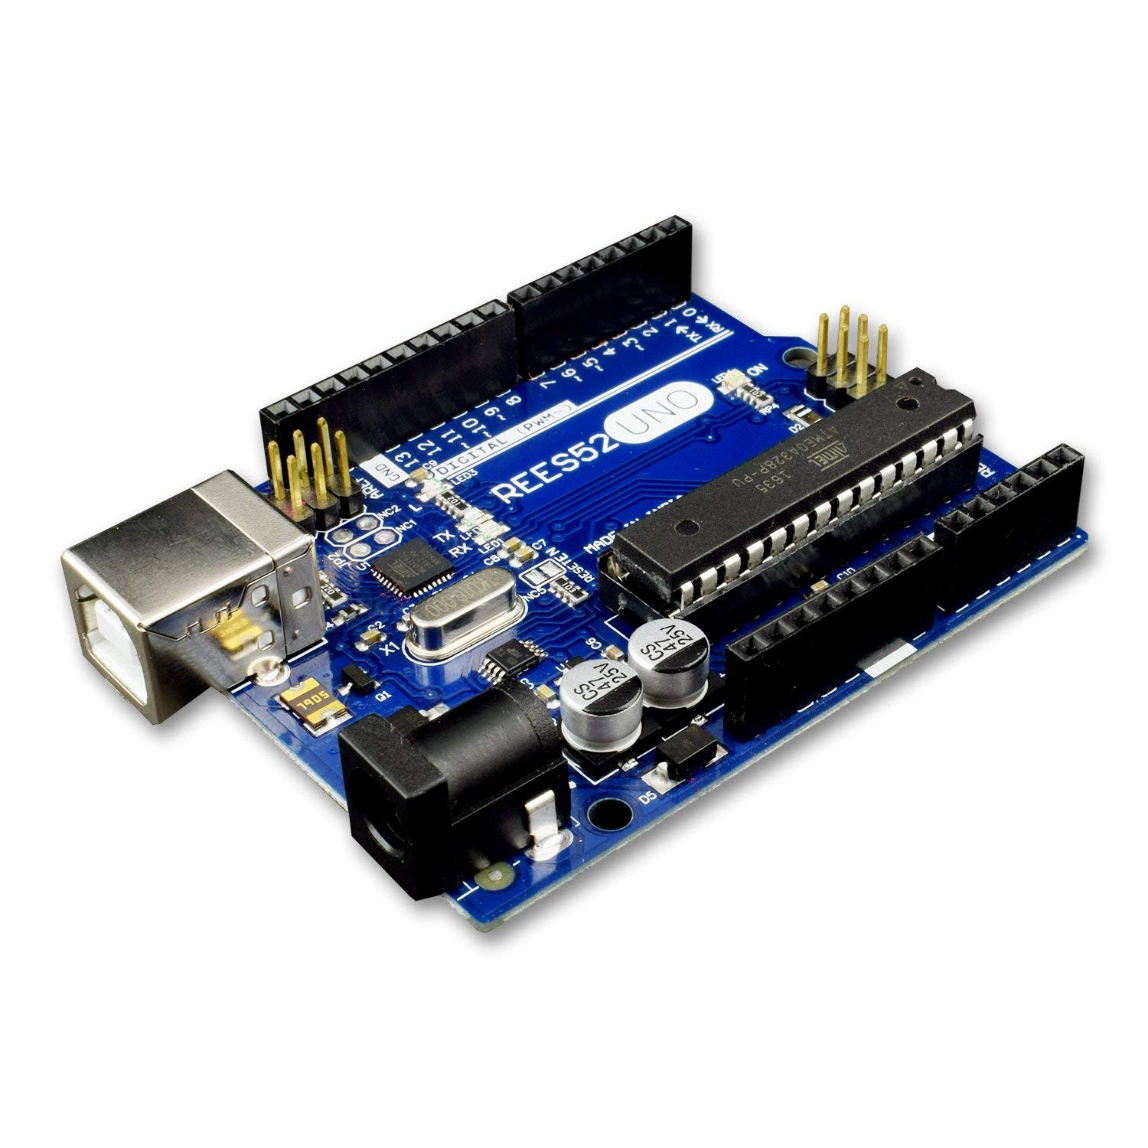
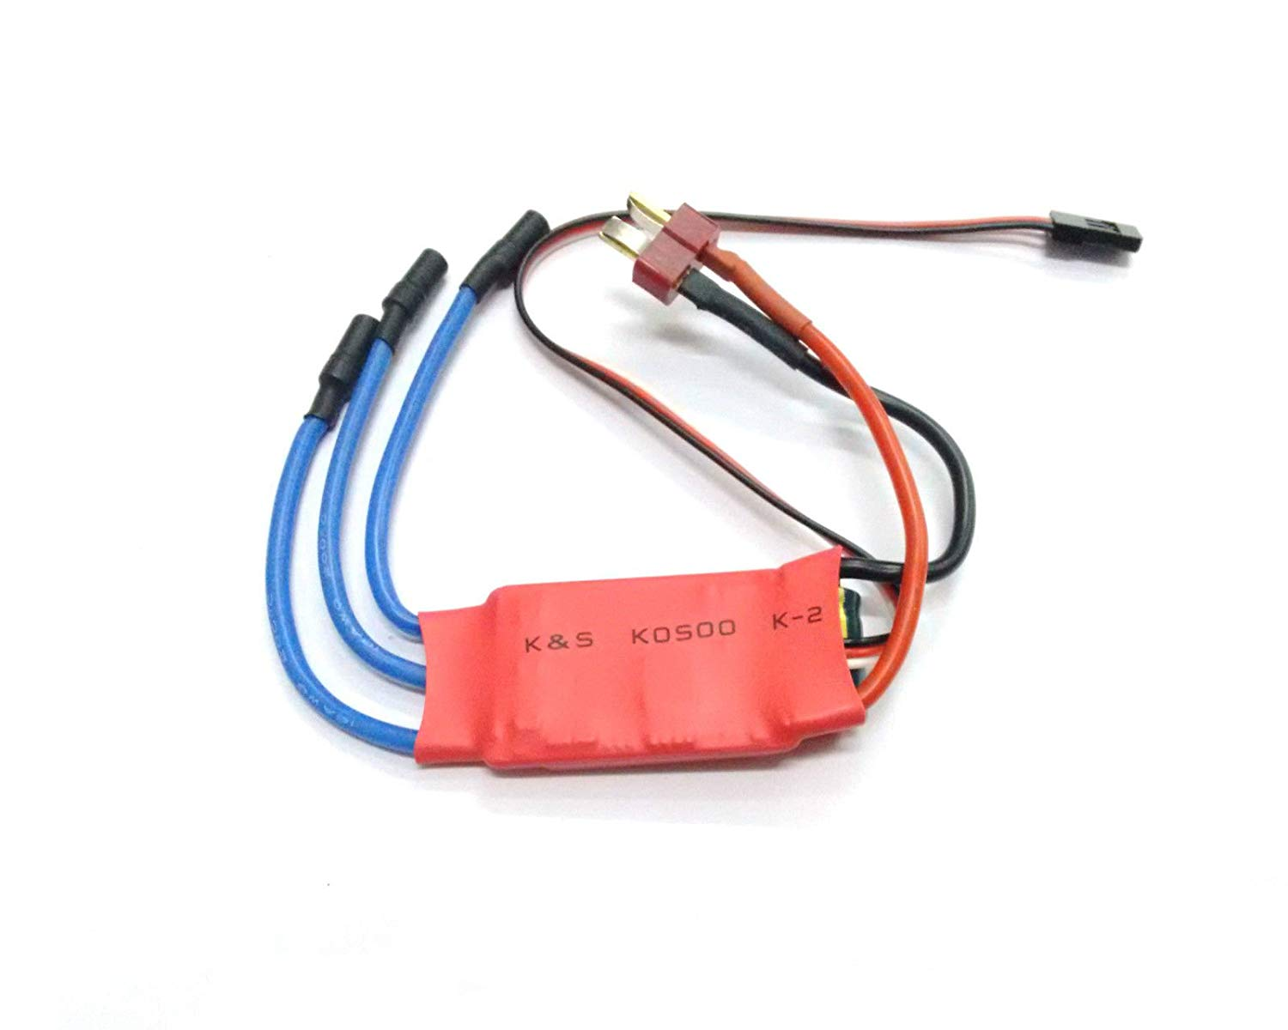
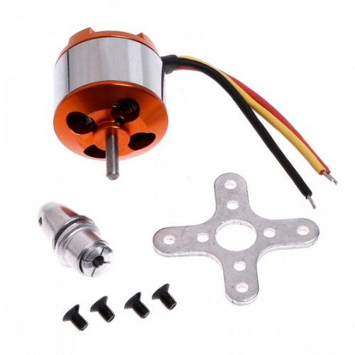
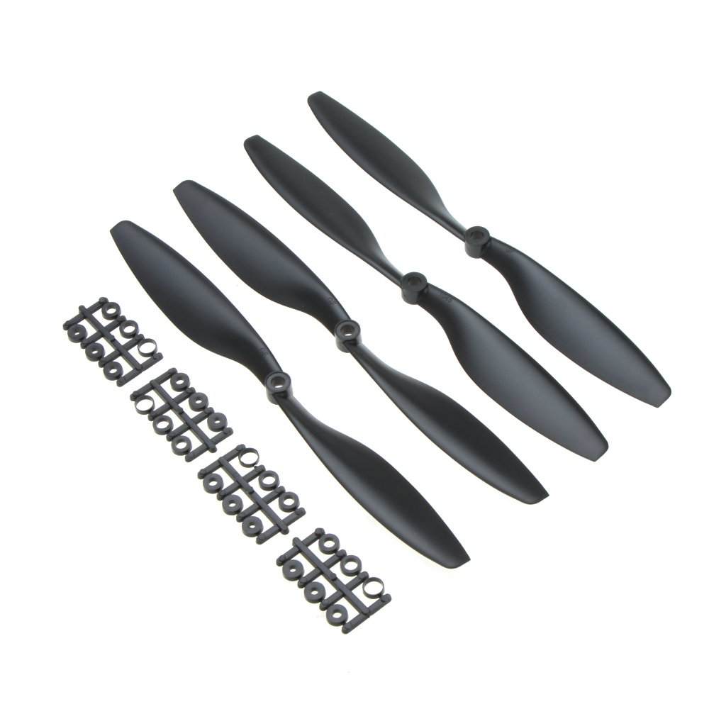
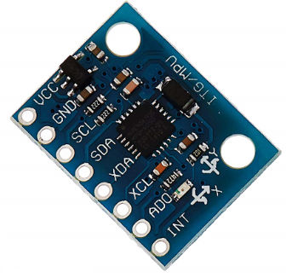
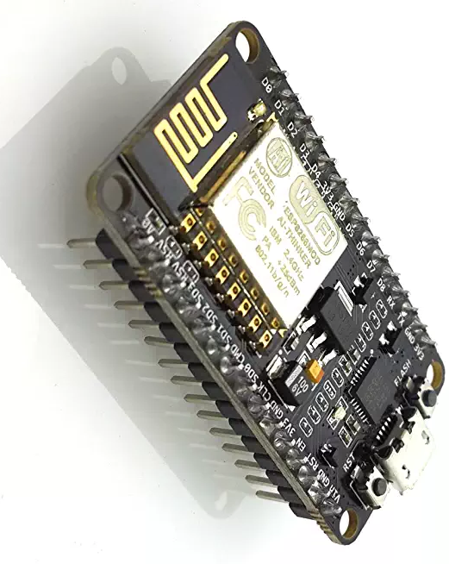
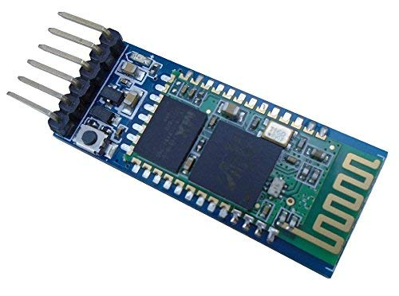
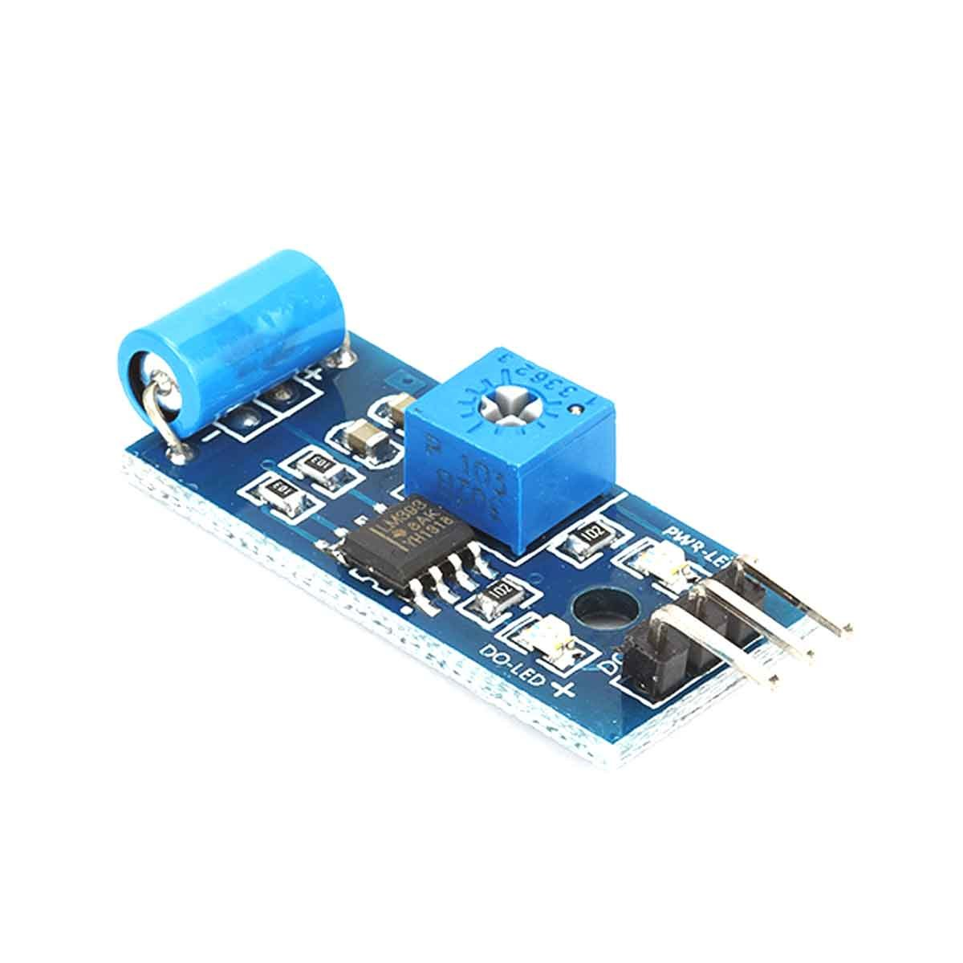
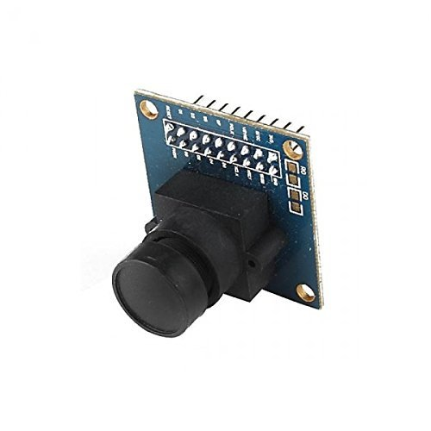
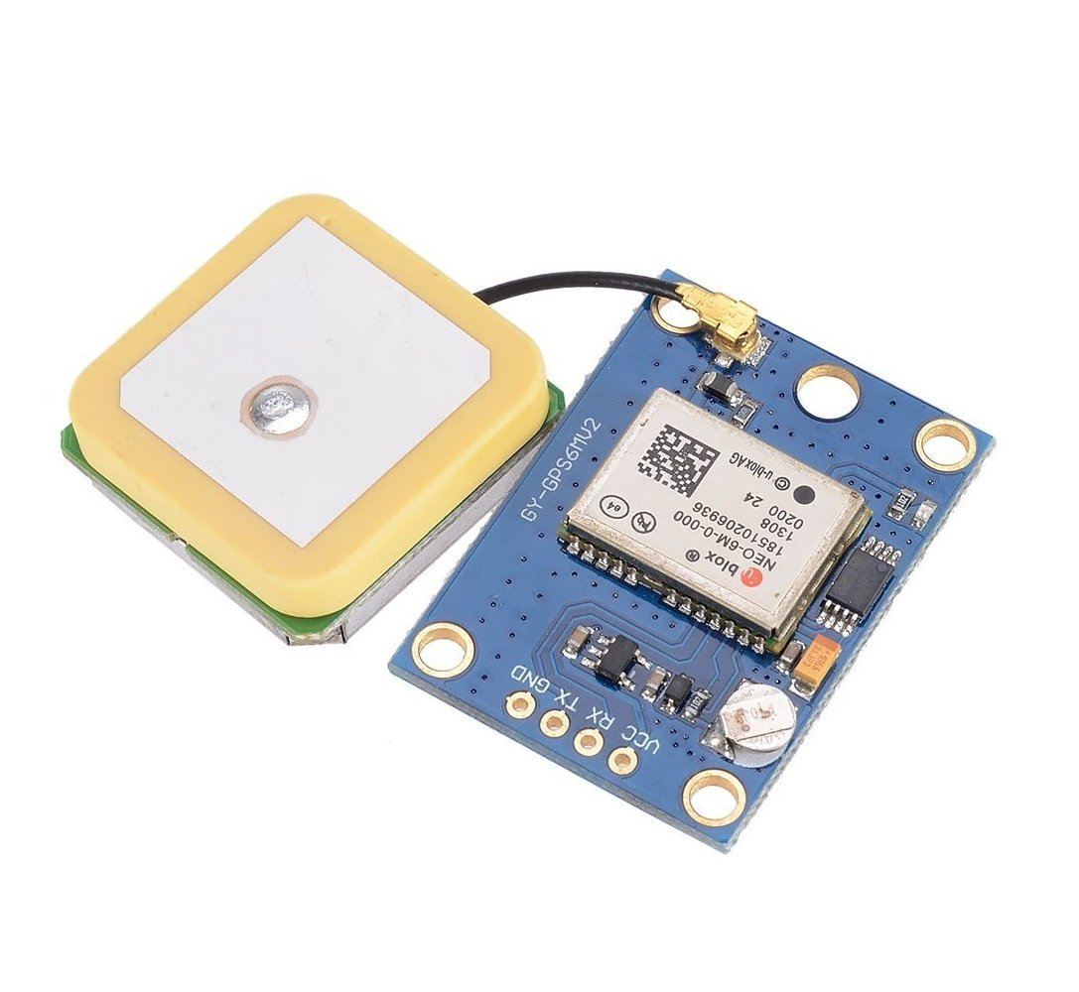
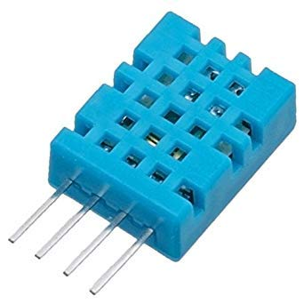
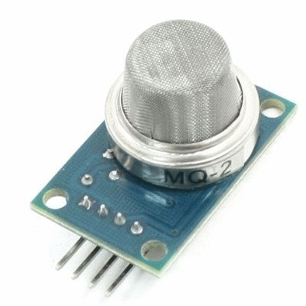
Hardware
Electric Speed Controller
Motor
Propeller
Arduino board
Gyroscope & accelerometer
Bluetooth/Wi-fi module
Temperature &
Humidity Sensor
Gas detector
Vibration Sensor
Camera
GPS Module

Slide 5

Hardware functions
In our project, an Arduino microcontroller is used to control the quadcopter flight dynamics
Arduino board
ESC controls the speed at which the motor must rotate
Electric Speed Controller
Motor design and propeller direction for propulsion to basically control the force of gravity against the quadcopter
Motor & propeller
The accelerometer measures the acceleration along one direction, while the gyroscope measures the angular acceleration on one axis.
Gyroscope & accelerometer

Slide 6
Hardware functions
Wi-Fi module to wirelessly communicate with the quadcopter from the ground station.
Bluetooth/Wi-fi module
To measure the pressure, humidity and temperature of the area to where the quadcopter is travelling to.
Temperature & RH sensor
To detect smoke and inflammable gases.
Gas Detector Sensor
To detect vibration and buzz if vibration detected.
Vibration Sensor

Slide 7
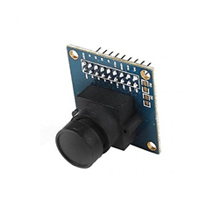


Hardware functions
Provide live streaming of the area back to the ground controller.
Camera Module
GPS module would give the coordinates of the quadcopter to where it will be flying
GPS Module
Software
The open-source Arduino Software (IDE) makes it easy to write code and upload it to the board.

Slide 8
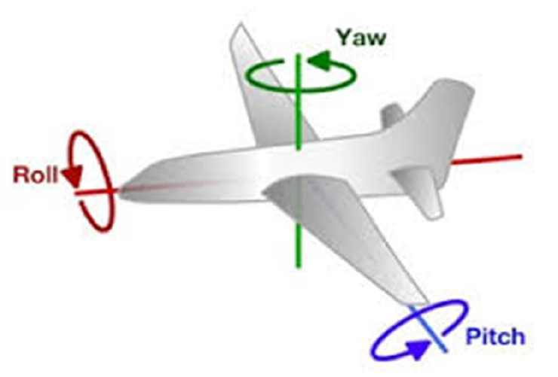
Flight mechanism
YAW (turning left and right)
ROLL (tilting left and right)
PITCH (moving up and down, similar to nodding)

Slide 9



